Slide 1
SQA FUNDAMENtALS bootcamp 2008
A quality journey

Slide 2
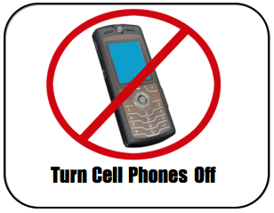
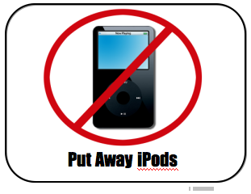
Logistics

Slide 3
Introductions
Who am I?
Who are you?
What do I expect?
What skills should you leave here with?

Slide 4


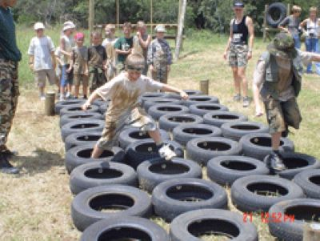

QE Boot camp - 2008
This is a foundation course if you plan to become a Software tester.
This course is designed to provide a macro overview of the software testing area by covering roles and responsibilities, test techniques and test planning.

Slide 5
Prerequisites
No testing experience needed
Some familiarity with development phases of a project will be helpful
Some puzzle solving and mathematics would help

Slide 6
Agenda
- We will define the SQA process
- Identify SQA relationship with SDLC
- Importance of SQA on the SDLC
- Activities and responsibilities of the SQA team
- Difference with SQE, Testing
- Responsibilities of a tester
- Software testing
- Characteristics of a good software tester
SQA
SDLC
SQE, Testing
Software Testing

Slide 7
What is Quality ?
Popular views about quality
Quality related to class and taste
Quality is related to quality life
Quality, simplistically, means that a product should meet its specification.
Quality – the degree of excellence of something. We measure the excellence of software via a set of attributes. [Glass1992]

Slide 8
Software Quality
Software quality is :
The degree to which a system, component, or process meets customer or user needs or expectations. [IEEE_Std_610.12-1990]
Conformance to explicitly stated functional and performance requirements, explicitly documented development standards, and implicit characteristics that are expected of all professionally developed software. [Pressman2004]

Slide 9
Historical Evolution
Until 1940
Individual task control
1918 Ford Motor Company
1930 Bell Labs
Until 1980
Statistical control
Less competitive market
No defect products ship to market
1970 Japan Total.. Quality Control

Slide 10
Historical Evolution
Since 1980 ….
A competitive market driven by quality
New quality models
US interested on TQM
1987 ISO 9000 (British influence)
Today
ISO 9001-2000
Quality affects societies
It is a culture, a strategy, a new style of management

Slide 11
Introduction to SQA
Software Quality Assurance (SQA) consists of the software engineering processes and methods used to ensure quality. SQA encompasses the entire software development process, which may include processes such as reviewing requirements documents, source code control, code reviews, change management, configuration management, release management and of course, software testing.

Slide 12
Objectives of SQA
Only Quality Control (testing) is not enough:
What would you do if your software does not pass the QC test?
QC is a reactive approach, not a proactive one.
Quality Assurance includes Proactive as well as Reactive approaches.

Slide 13
Purpose of SQA
Practically, a zero defect product is not possible to achieve.
The purpose of quality assurance practices are to minimize the number of defects.
How much effort is needed to minimize the number of defects?
are you developing a customized project or product?
how critical is your application?

Slide 14
Organizational Positioning of SQA (Observed)
CEO
Development
Manager
HR
Manager
Admin
Manager
SQA
Manager
Project
Lead 1
Project
Manager
Project
Lead 2

Slide 15
Organizational Positioning of SQA (Recommended)
CEO
Admin
Manager
Development
Manager
SQA
Manager
Core
Manager
Support
Manager
Project
Lead 1
Project
Lead 2

Slide 16
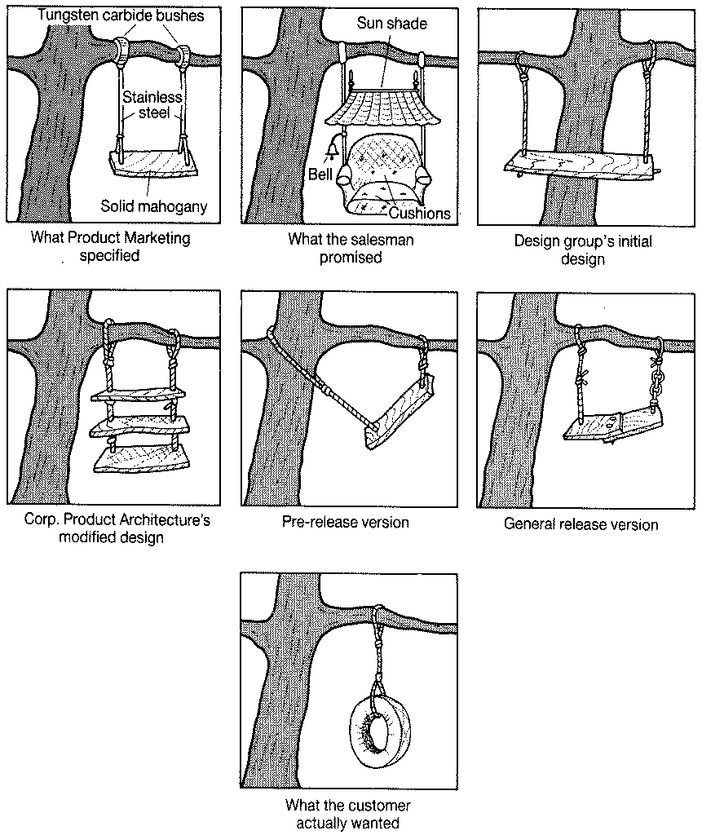
SQA and SDLC

Slide 17
SQA responsibilities in a project
Review documents developed by the development team.
Track the compliance with the standards.
Development of a QA Plan (test plan + test cases).
Implementation of test cases (Black Box or Glass Box Testing).
Management of bug repository.
Participating in code and design reviews.

Slide 18
Why do we test ?
Some examples of software errors
http://www.cs.tau.ac.il/~nachumd/verify/horror.html
An average person has his own computer at home.
Free software is even attached to cereal boxes.
We are surrounded by techie gadgets
Cell phones, BB, palms….
Most of us cannot go a day without logging on the internet to check our mail.
Software is everywhere. However, it's written by people so it's not perfect

Slide 19



Infamous Software errors – life without SQA
NASA Decides That A Software Error Doomed The Mars Global Surveyor Spacecraft.
The Patriot Missile Failure
In August of 2006 a U.S. government student loan service erroneously made personal data public .

Slide 20
Why do we test ?
Testing is a costly activity
We want to recover some of that cost
We do this by adding value to, or raising the quality of, the program or system we are testing
Thus: Testing is the process of executing a program with the purpose of finding errors.

